Slide 1
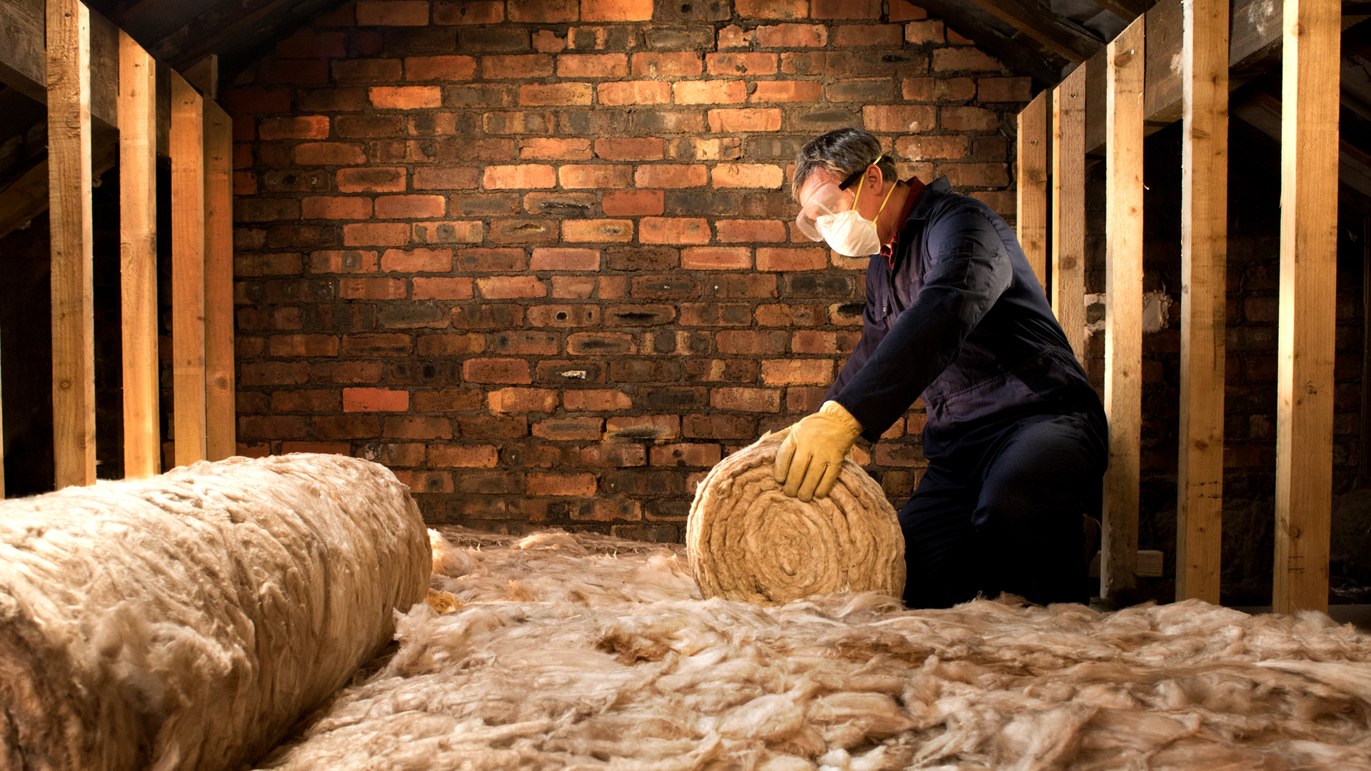
Introduction to Public Health’s Warm Homes service Presented by Alex Clark Warm Homes Manager
Notes:
Warm Homes – advice service based within Public Health / Community Delivery team at Leicestershire County Council
Home energy is a huge topic of discussion but limited time so our focus today is on the current processes around retrofitting homes and our HERO scheme and other funding that can support residents.
Wider advice on the cost-of-living support available via the LCC website.

Slide 2
Telephone Advice
We offer telephone advice which we follow up with a letter or email. Advice line is open to all Leicestershire County residents 18+ of any tenure of housing.
Home Energy Retrofit Offer (HERO)
We now offer a home visit through the HERO project, followed up by a telephone call, letter or email. This service is available for Homeowners and Private Tenants (income, age or health-based criteria applies).
Notes:
Advice and signposting, deliver some grant funded projects providing 1-2-1 advice and energy efficiency improvements.
Affordable Warmth
Fuel Poverty
Excess Winter deaths

Slide 3
How can Warm Homes help?
Signposting to grants to improve energy efficiency
Energy tariff and debt advice
Advice on dealing with damp
Behaviour change
Heating and hot water controls
Tips on draughtproofing to keep the home warmer
Support in emergency situations (no working heating)
Priority Services Registration in case of power cut
Check eligibility for Government support
(energy bill discounts, grants for energy efficiency measures)
Notes:
Adults, support any tenure of property – more grant support for home improvements aimed at private sector homes.
Social housing offers tend to be managed directly by the housing provider.
Service specification is about tackling fuel poverty – complex definition but essentially considers how much proportionally residents have to spend on energy bills as a proportion of total income and whether what’s left after this pushes them below the poverty line in remaining income for other essentials.
Focus on helping residents to maintain affordable warmth

Slide 4
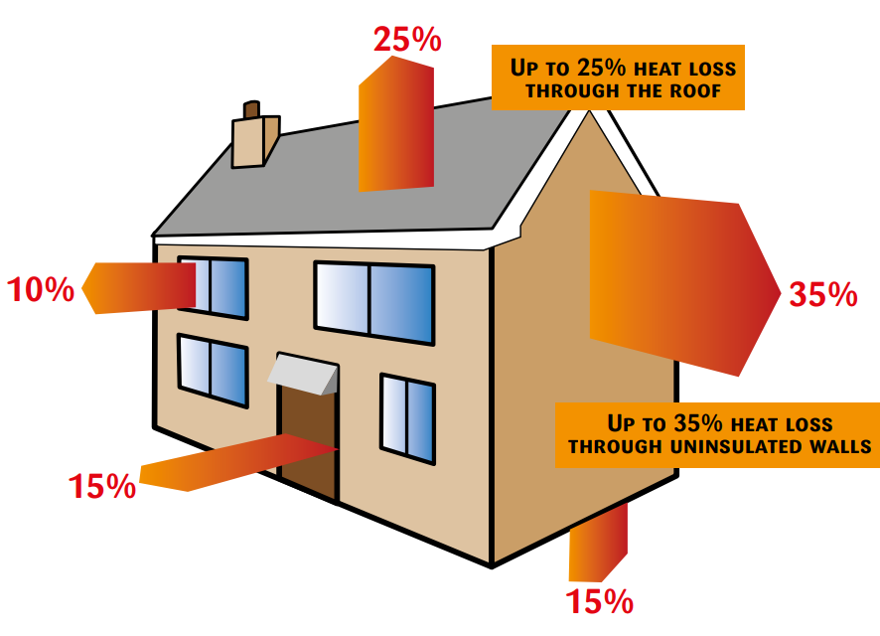
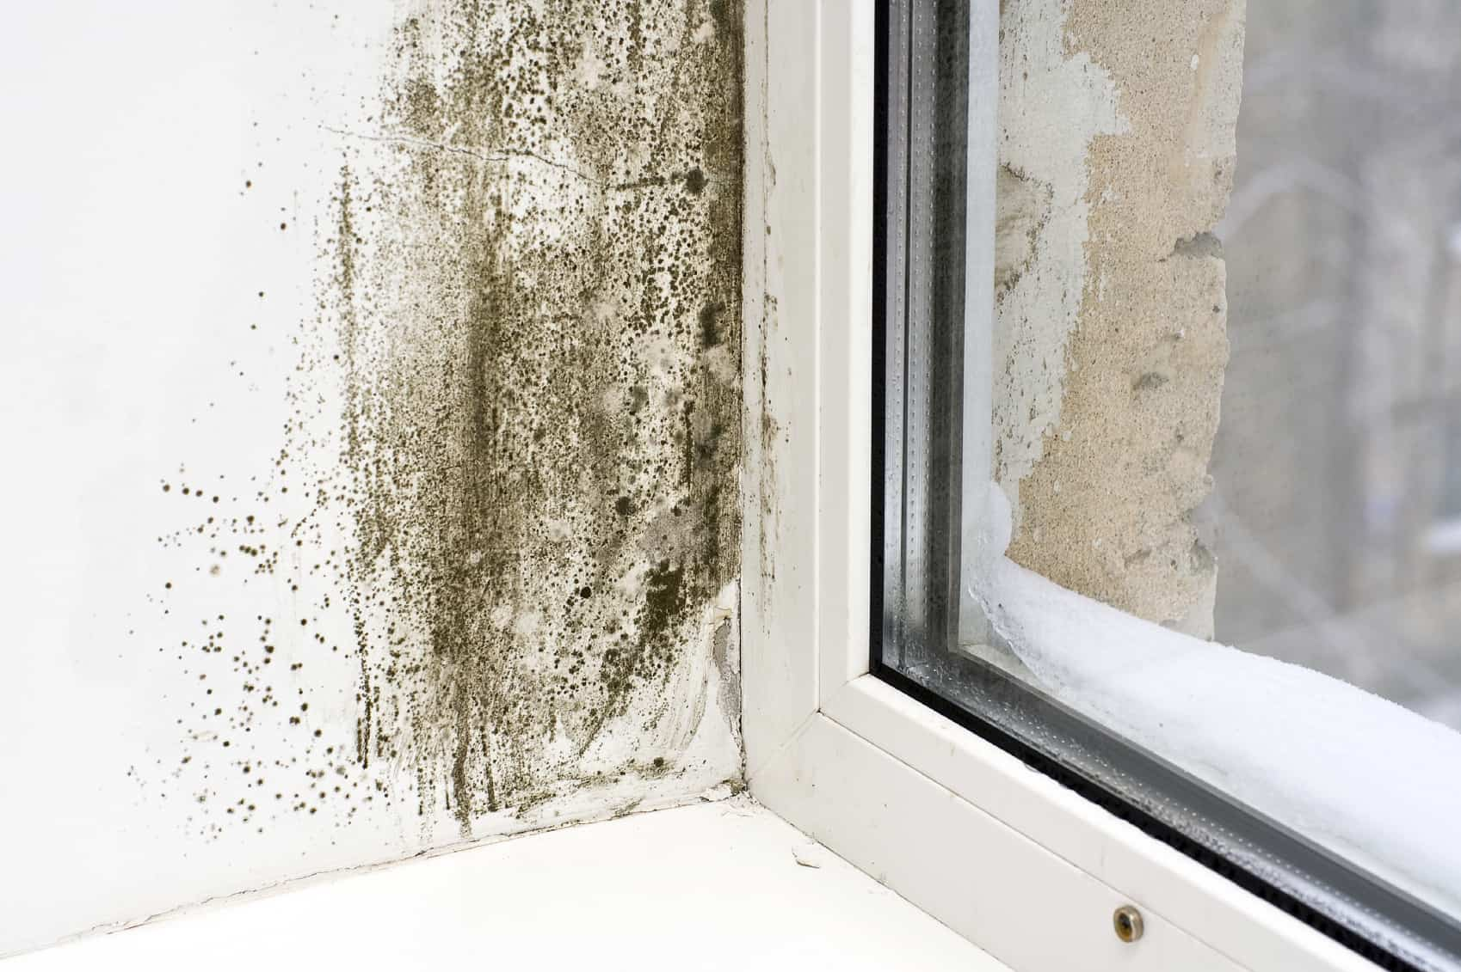
Why homes need upgrading
Our homes are leaky!
Currently 80% of assessed homes built before 1930 in England and Wales have average to very low energy efficiency rating. (ONS 2023)
With homes built before 1900 the least likely to be energy efficient due to different building methods
It is more difficult to maintain warmth and comfort in a property that is energy inefficient, requiring more fuel and increased cost.
Heating is the biggest energy use in the home.
Reducing the heating demand saves money and reduces the environmental impact from burning fossil fuels at home and to generate energy nationally.
Inefficiency can negatively impact the building fabric, your health and comfort.
Notes:
The UK has some of the least efficient homes in Europe. This is particularly pronounced in private sector housing – homeowners and private tenants. Social housing s typically
With cost-of-living pressures in recent years the proportion of households living in fuel poverty has increased.
There are cross party pushes to build more new homes which would improve the picture of average energy efficiency however the UK has a higher proportion of older properties meaning investment in these older inefficient homes is vital to achieve this.
The energy efficiency of a home is based on a standard assessment producing an energy performance certificate.
Older homes can be more susceptible to cold spots and problems with condensation, water getting in and damp and mould as a result.
Excess Winter Deaths (more people die over the winter) – higher in the UK than European neighbours with colder climates is in part due to poorer energy efficiency and colder homes.
Fuel Poverty charity National Energy Action has said that of the 13,400 EWDs in winter of 2021/22, 30% or 4,020 of these were caused by the impact of cold homes. A real Public Health reason to effect improvements.
In 2019 the former Government department for Business Energy and Industrial Strategy said at a Select Committee that it estimated that for every £1 spent on retrofitting fuel poor homes the NHS could expect to save 43p.

Slide 5
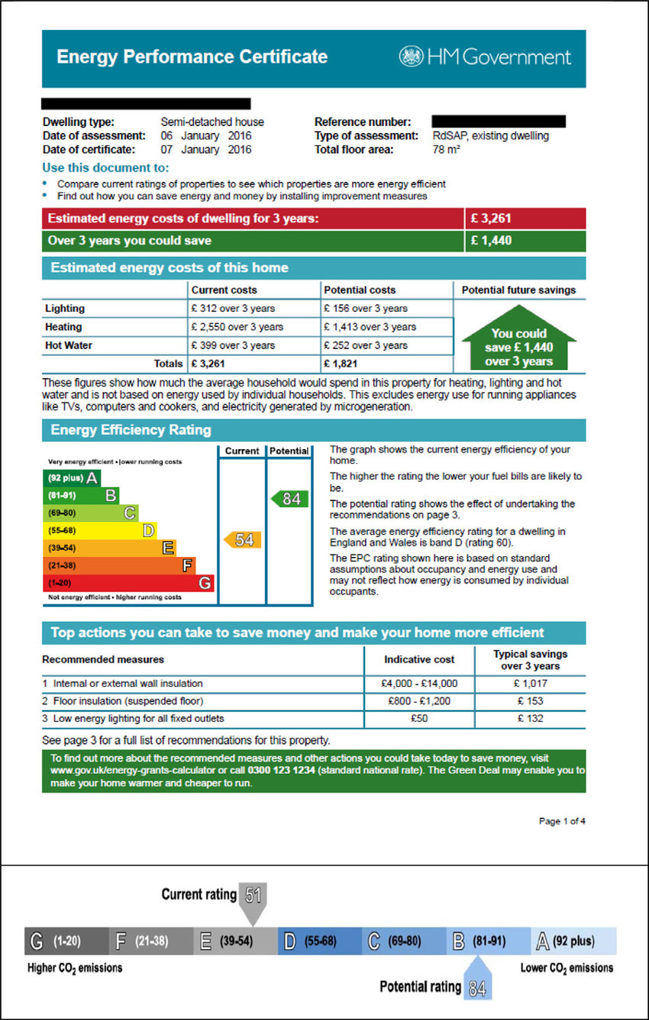
Financial support
Grant schemes and projects
National
Energy Company Obligation (ECO)
Boiler Upgrade Scheme
Great British Insulation Scheme (GBIS)
Local
Home Upgrade Grant
Solar Together
Flexible Eligibilty access to ECO
Future
Warm Homes Local Grant – first property fully funded, additional properties require landlord contribution
Notes:
All of these schemes have elements which can benefit the private rental properties/tenants. Some may have restrictions based on EPC rating or require certain measures be present or installed in conjunction.
Typically, non of these scheme can address whole house retrofit (to undertake every possible recommendation on an EPC) within funding limits but can support a range of measures.
Typically require a tenant to be eligible as well as property itself. – Not always however, BUS and GBIS do not.
Typically require a contribution or limited to certain measures. GBIS for example can provide 1 insulation measure.
The average home EPC rating is band D. The focus of Government programmes is to target support to inefficient homes to improve this rating as far as practicable.
Increasingly it is a requirement to have an EPC D rated or below to access grant funding.
All these schemes have eligibility requirements and provide different levels of support.
Some are means tested and others are not.
ECO – Energy Company Obligation
Is funded through energy companies obligation for properties with an EPC of D or below, and can offer a range of insulation with 2 routes. A contribution to the cost maybe requested. For private rental properties the EPC must be E or below. You could argue that only useful to those meeting the MEES minimum requirement or with a valid exemption.
ECO4 - If you are on means tested benefit or have child benefit and a low income you can normally apply through your own energy supplier.
ECOflex – You may be able to go through your energy provider or through a TrustMark registered installer. This is for households with an income of less than £31,000 or a significant health condition. The Council carry out eligibility checks on behalf of installers, although don’t endorse any installer and not involved in the install. The criteria is on the Council Website.
Boiler Upgrade Scheme – A government funded scheme with a contribution of up to £7,500 to replace fossil fuelled heating systems such as those using gas, heating oil, electric or LPG with improvements, such as an air source heat pump or biomass boiler. Aimed at homeowners and private landlords. The scheme is not means tested but may require householder contribution. To March 2025.
Great British Insulation Scheme – This is a government funded scheme providing single insulation measures, such as loft or cavity wall. You cannot access both GBIS and ECO. You will need an EPC of D or below and Live in Council Tax band A-D (England). May require a contribution.
Home Upgrade Grant – Is a government funded scheme for properties without mains gas heating as their primary heating. This is accessible for Leicestershire properties with EPCs of D or below (an EPC will be provided if there is not one on the property) and household eligibility is for household income under £36,000, means tested benefit or living within an identified postcode. This is run through the council and free for homeowners and a contribution is needed for eligible landlords (see council website for more details). The measures offered are determined from a retrofit assessment and availability.
Solar Together – Solar Together Leicestershire is an innovative scheme offering high-quality solar photovoltaic (PV) panels and battery storage. It is a group-buying scheme (delivered through iChoosr Ltd), which brings Leicestershire households together to get high-quality solar panels at a competitive price, helping you through the process and keeping you informed at every stage. This is not a grant but a means of seeking quality products and competitive prices through group bulk buying power with the assurance of being a council backed initiative. Runs in phases.
Local projects delivered in partnership with district authorities – Green Living Leicestershire partnership to deliver projects supporting sustainability, energy efficiency.
Warm Homes Local Grant – Government policy – starting to reflect the challenges and lack of uptake in the private rental sector – In this new scheme which will be delivered via local authorities and their delivery partners –
Currently at expression of interest stage so more details to come in the new year with projects starting to deliver later in 2025. Subsequent properties are 50% grant funded and 50% landlord contribution. F and G registered properties must have valid exemptions under the Energy Efficiency regulations for private rental properties.

Slide 6
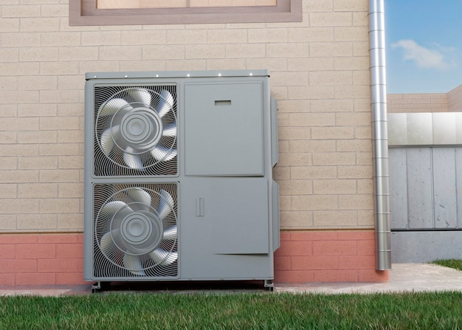
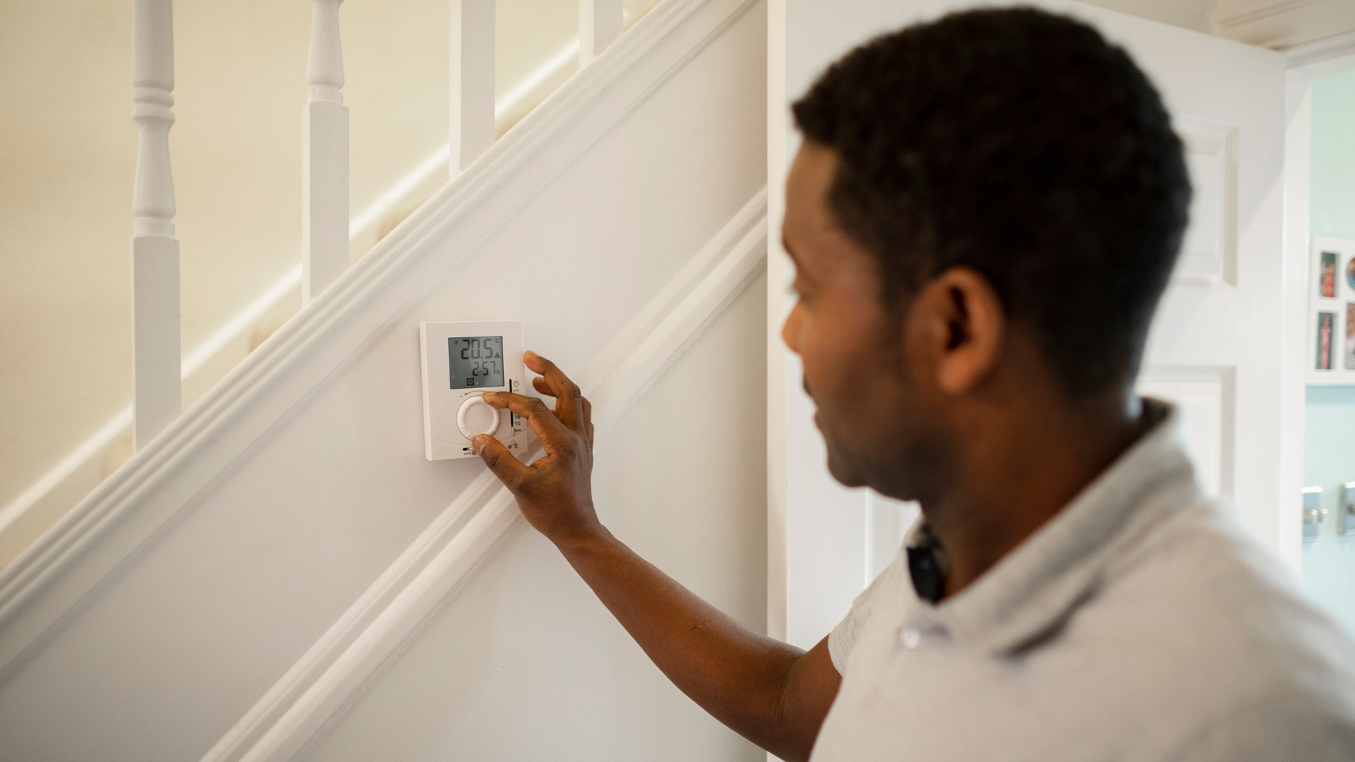
Retrofit examples
Notes:
Insulation – loft, cavity wall, external or internal cladding,
Heating upgrades such as a more efficient boiler or electric storage heaters or low carbon technologies such as heat pumps which work in their simplest form like a fridge in reverse pulling heat from outside and dissipating it into the house via radiators.
heating controls,
upgrading to low energy lighting
renewable technologies such as solar pv panels to generate electricity or solar thermal panels to produce hot water.
Case studies – to share from Leicestershire residents who benefitted under the previous scheme we delivered – using sustainable Warmth competition funding.
Attribute image:
<a href="https://www.freepik.com/free-photo/close-up-hands-changing-lightbulb_14351779.htm#fromView=search&page=1&position=22&uuid=af482784-264d-4375-b321-9482571d9ad3">Image by freepik</a>

Slide 7
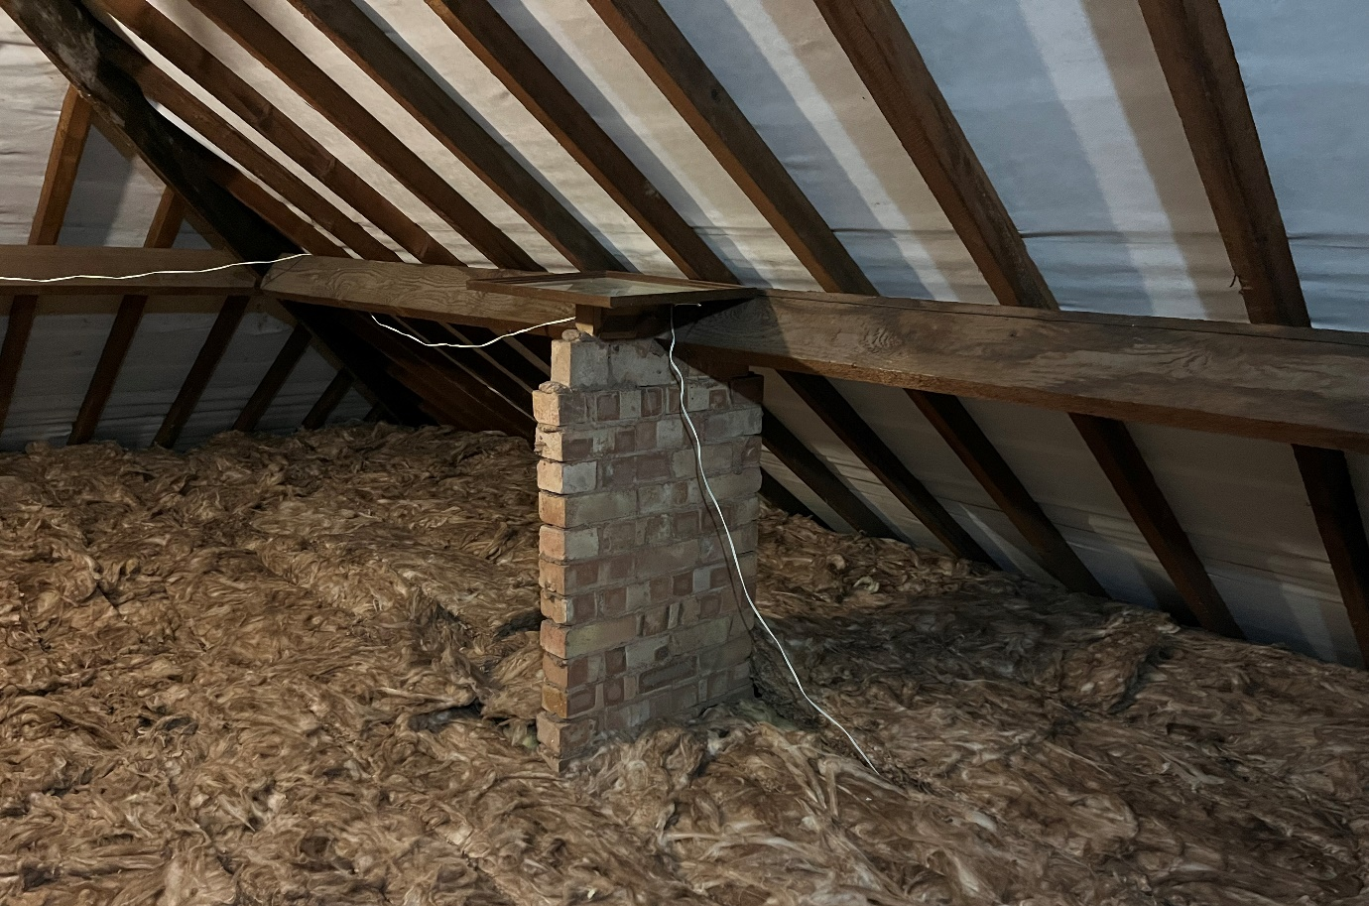
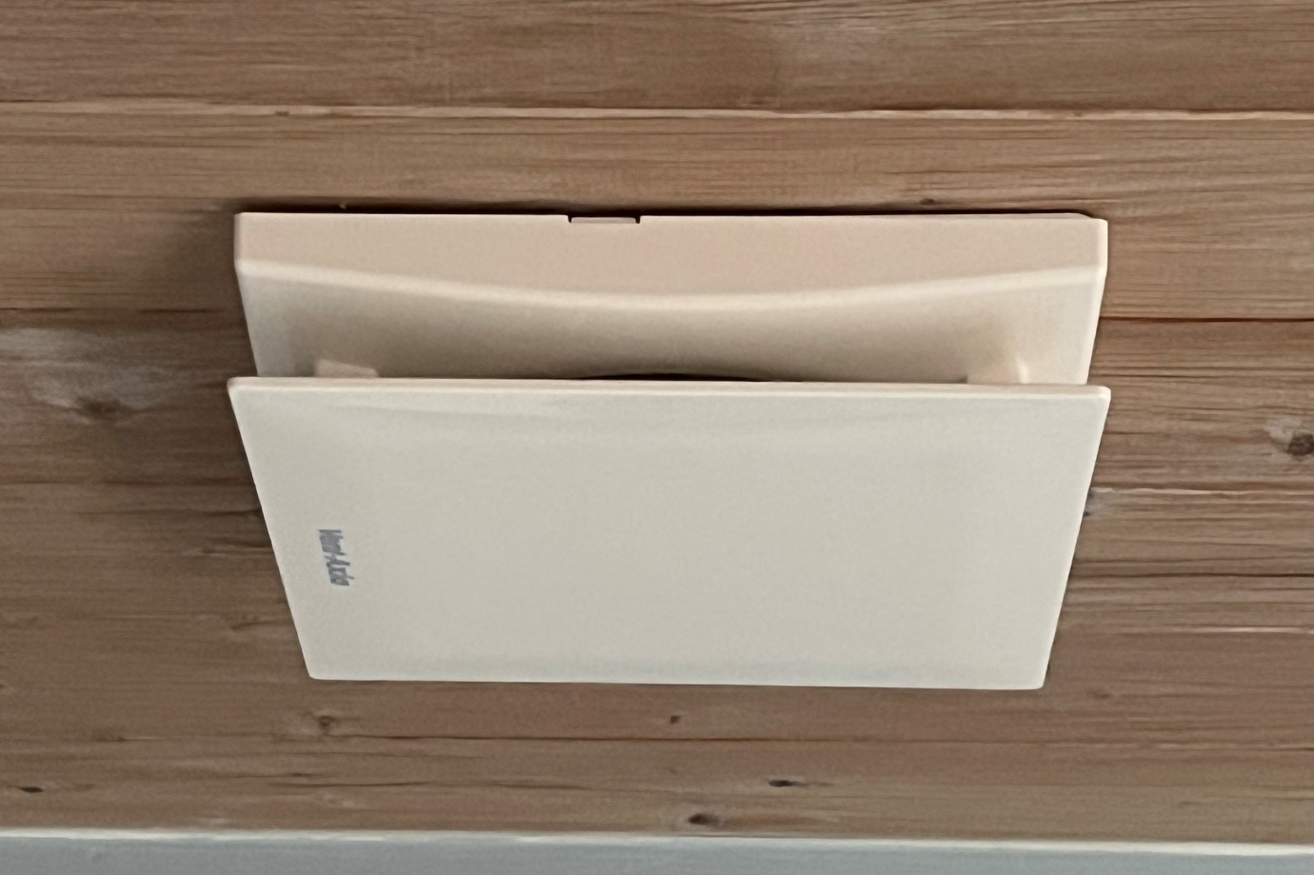
Retrofit Standards
PAS2035 – Overarching retrofit standards framework
PAS2030 - Quality of Installation processes
Ventilation
Case study - Loft Insulation, ventilation
Mr Green – Blaby resident
What are the benefits?
“(The house) certainly seems warmer and the bathroom no longer fills with condensation when having a shower”
“The whole process from application to install has been really simple”
Notes:
Government introduced new standards in recent years to support better delivery of energy efficiency measures. New requirements on advice to residents and ventilation requirements assessing the whole property and mandating measures to access energy efficiency measures. This can include undercuts of doors, mechanical extractions and trickle vents.
PAS 2035 requires specific roles to advise, assess, design and coordinate packages of measures for homes and to ensure a whole house assessment of what measures are effective even if they aren’t all done at the same time.
Link in with Housing and Respiratory Illness project led by HBBC to support homes struggling with damp and mould issues where poor energy efficiency may be a factor.
I thought it would be useful to include some real local Leicestershire examples of residents that have benefitted under recent grant programmes we have delivered.
In 2023 our home energy grant (Sustainable Warmth Competition funding) supported both on and off gas home to realise a range of improvements.
3. Case study 3 – heating costs calculated to have reduced by £213 a year.

Slide 8
HERO – Home Energy Retrofit Offer
Advice offer for all households via telephone – targeting homeowners and private tenants
Support to navigate and access grants and schemes
Follow-up conversations and feedback
Demonstrator project
Those eligible for additional assistance could receive
Home visit
EPC assessment (owner-occupiers)
Retrofit assessment (owner-occupiers)
Thermal images of heat loss in their homes to help visualise where homes are inefficient or leaky
Notes:
Example of literature we have been disseminating via public spaces and Community Delivery teams such as Local Area Coordination.
Targeted communications to areas with older homes, higher deprivation, off-gas that are more likely to have energy inefficient homes that could benefit from advice.
We can provide advice to all we speak to however additional support can be provided where eligible to provide free home visits and potentially assessments to determine the EPC rating of a property and enable access to grant funded schemes.
We can provide advice to all private sector households (Homeowners and Private Tenants) however additional support may be provided where:
- household income is below £31,000 or in receipt of benefits
- Your circumstances put you at risk if living in a cold home (long term health conditions or all occupants are over 65)
& Your energy performance rating is between D – G - your home does not have an energy performance
e rating and was built before 1991.
We may be able to offer further support to low-income households or vulnerable residents requiring face to face support at home. This may include arranging a free survey and advice report to pinpoint the most effective measures.

Slide 9
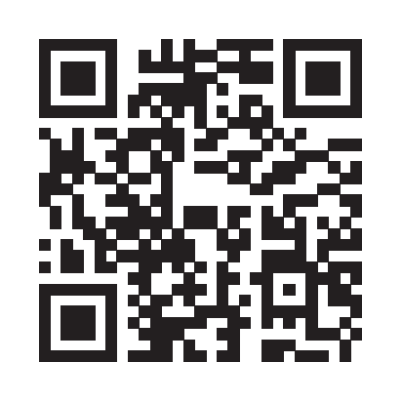
How to refer
18+, Any housing tenure
Online: (professional or self-referral forms)
www.leicestershire.gov.uk/home-energy-grants
www.firstcontactplus.org.uk
www.LLRjoy.com
Email: (professional)
warmhomesinfo@leics.gov.uk
Phone: 0116 305 2524
Please seek permission from the resident before making a referral
Please identify what support they require
We will require some basic information such as their name, date of birth, address, phone number.
Additional information will be helpful such as tenure, benefits, email.

Slide 10
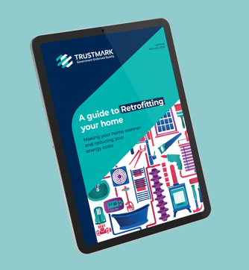
Thank you Contact details Useful resources Any questions?
Call: 0116 305 2524
(Monday to Friday, 9:00am - 4:30pm)
Visit: www.leicestershire.gov.uk/retrofit
Newsletter sign-up and energy saving advice:
www.leicestershire.gov.uk/home-energy-grants
TrustMark: www.trustmark.org.uk/homeowner
> Retrofit Guide
www.gov.uk:
‘Understanding and addressing the health risks of damp and mould in the home’
– range of specific guides for landlords and tenants.
UKCMB – UK Centre for Moisture in Buildings:
Video guides to moisture and mould in the home.
Notes:
For advice via our Warm Homes service and the HERO offer – telephone, front line professionals can refer via First Contact Plus network, Joy Marketplace or by completing a form via the LCC website. Our advisers then work to identify best route for advice.
Scan the QR code for link to our HERO scheme pages.
Home energy grants pages – can find more general energy saving advice in a dedicated booklet covering a broader range of topics than covered here today.
TrustMark – Government endorsed competent person register – resident can find installers of measures and advice. See the Retrofit guide, as pictured.
Retrofit Academy – CiC – Community Interest Company focused on promoting and developing retrofit skills. Provide training and advice.
Thank you

